Slide 1
Abstract Data Structures
TOPIC 5.0 – ABSTRACT DATA STRUCTURES
TOPIC 5
5.1.11 – 5.1.13: Linked Lists

Slide 2

REVIEW REVIEW REVIEW REVIEW REVIEW REVIEW
THE WARM-UP QUESTION
List three things that queues could be used for when creating a program
You may reference last lesson’s slides, but at least one should be original

Slide 3
REVIEW REVIEW REVIEW REVIEW REVIEW REVIEW
THE WARM-UP ANSWER
Simulating a real-world queue (restaurant, venue)
Operating System handling different processes
Printing queue

Slide 4
Topic 5.1.8 – ABSTRACT DATA STRUCTURES
Lists
Chat, what is a list?
No, really, what is a list?
How does it work?
Does anybody know?

Slide 5
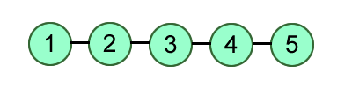
Topic 5.1.11 – ABSTRACT DATA STRUCTURES
Lists
The list is an Abstract Data Type, and is more accurately referred to as a Linked List
Each item is an object, and it is linked to the next item in the list
Hence, linked list

Slide 6
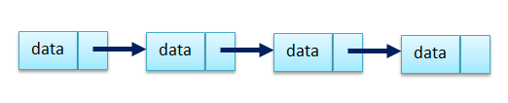
Topic 5.1.11 – ABSTRACT DATA STRUCTURES
LINKED Lists
Each item in a linked list is an object, and it has a reference to the next object in the linked list.
It also has a field to hold the data the node is intended to hold.

Slide 7
Topic 5.1.11 – ABSTRACT DATA STRUCTURES
The NODE
A linked list is constructed of nodes, each containing a piece of data and a link to the next node
If there is no next object in the list, the node will lack a node to point to. We call this a null pointer.

Slide 8
Topic 5.1.12 – ABSTRACT DATA STRUCTURES
LINKED List Traversal
To navigate a linked list, you must start at the first node
We call this the head node
We then go from node to node, following the pointers to each other node
Length can be as long as it needs to be, we use loops or recursion to access the next nodes.

Slide 9
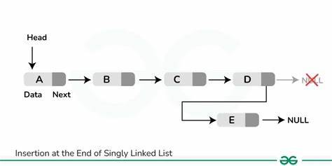
Topic 5.1.12 – ABSTRACT DATA STRUCTURES
Linked list – add items
To add items to a linked list, we have a few options:
We can add it to the end of the list, removing the null pointer from the last item, replacing it with a pointer to the new item, and putting the null pointer on the newly added item
This is equivalent to a .append() operation

Slide 10
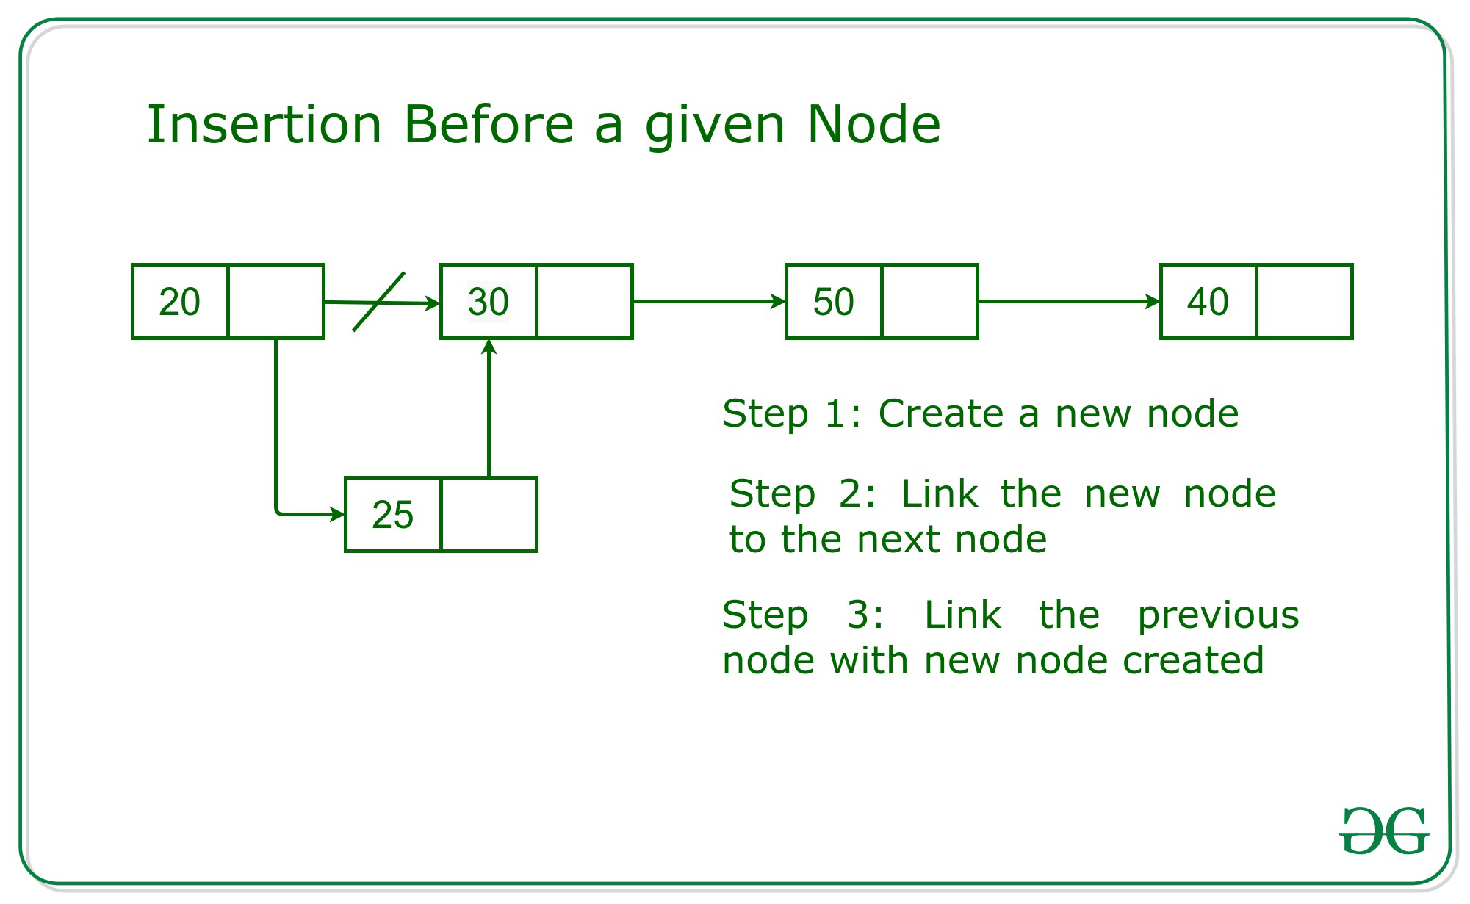
Topic 5.1.12 – ABSTRACT DATA STRUCTURES
Linked list – add items
You can also put a node in between two existing nodes
If we want a new node at index 2, the node at index 1 will reference our new node, and our new node will reference the original index 2 node

Slide 11
Topic 5.1.12 – ABSTRACT DATA STRUCTURES
Linked list – add items
We must have a special case if the item being added is the new first object in the list
The head will now point to the new node

Slide 12
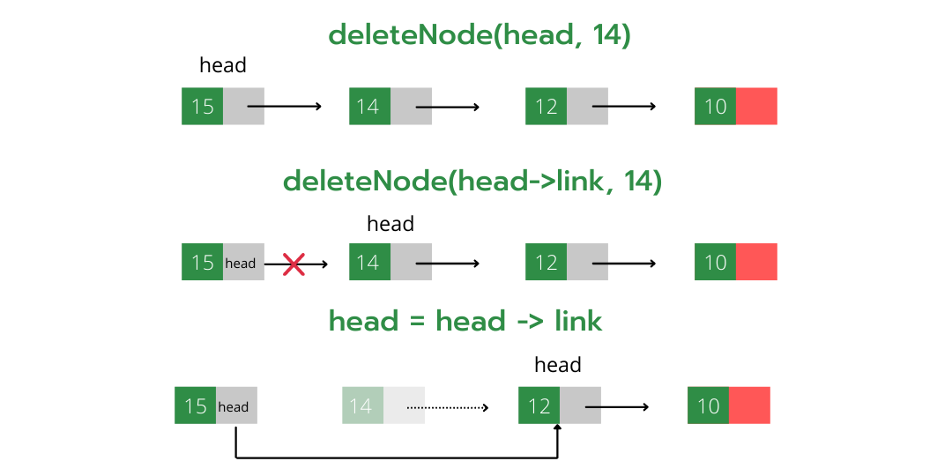
Topic 5.1.12 – ABSTRACT DATA STRUCTURES
Linked list – REMOVE items
To remove a given item, say index 2, the index 1 will now change its pointer to the node at index 3
The node previously at index 2 will be deleted by the system

Slide 13
Topic 5.1.12 – ABSTRACT DATA STRUCTURES
Linked list – REMOVE items
Removing an item at the start of the list requires a special edge case
We need to make sure the head is reassigned to the next node.

Slide 14
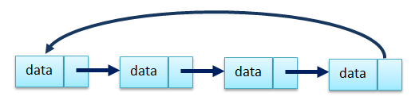
Topic 5.1.13 – ABSTRACT DATA STRUCTURES
CIRCULAR LINKED Lists
Circular linked lists have the last node loop back to the first node, this is useful when the list must loop infinitely

Slide 15
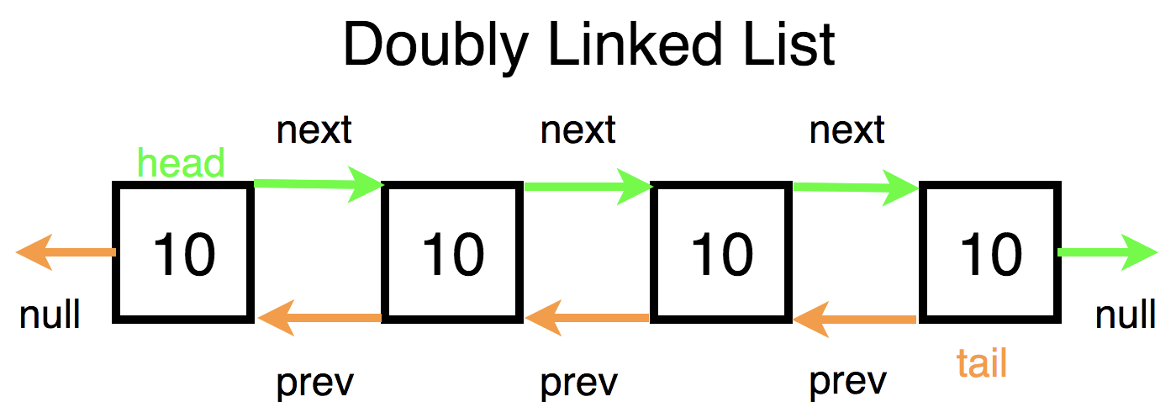
Topic 5.1.13 – ABSTRACT DATA STRUCTURES
DOUBLY LINKED Lists
Doubly linked lists have a reference to the next item, as well as the previous item
This is useful if the list will need to navigate back and forth for whatever reason

Slide 16
Topic 5.1.13 – ABSTRACT DATA STRUCTURES
FINDING DATA IN A LL
In a linked list, we could search by index or by data we are searching for
For index, we loop for the range of the item index we want
X = input(“Give an index”)
NODE = LL.head
loop I from 0 to X - 1
NODE = NODE.next
end loop
return NODE.data

Slide 17
Topic 5.1.13 – ABSTRACT DATA STRUCTURES
FINDING DATA IN A LL
In a linked list, we could search by index or by data we are searching for
For data, we loop while the node does not have the data we want
DATA = input(“Give some data”)
NODE = LL.head
loop while NODE.data != DATA
if NODE.next != NULL then
NODE = NODE.next
end if
end loop
return NODE.data

Slide 18
Topic 5.1.13 – ABSTRACT DATA STRUCTURES
MODIFYING DATA IN A LL
To modify data in our list, we can access the data field in the node object
Because the node is an object, the data is just a variable inside of it
It could be of any type
DATA = input(“Give some data”)
NODE = LL.head
loop while NODE.data != DATA
if NODE.next != NULL then
NODE = NODE.next
end if
end loop
NODE.data = 12

Slide 19
Topic 5.1.13 – ABSTRACT DATA STRUCTURES
Linked list exercise
Draw a diagram representing a linked list
Then, draw a diagram of an item being deleted from a linked list
Then, draw a diagram of an item being inserted into a linked list

Slide 20

Topic 5.1 – THINKING RECURSIVELY
VOCAB TO REMEMBER
Linked List
Node
Pointer
Head
Circular Linked List
Doubly Linked List

